Slide 1
Resonance and AC power
Lecture 10

Slide 2
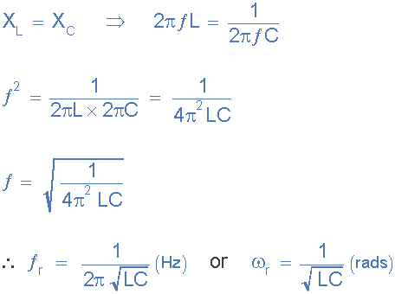
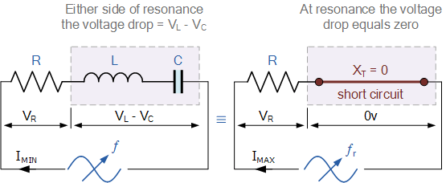


Basic
Electrical resonance occurs in an AC circuit when the two reactances which are opposite and equal cancel each other out as XL = XC and the point on the graph at which this happens is were the two reactance curves cross each other
Resonance occurs in a series circuit when the supply frequency causes the voltages across L and C to be equal and opposite in phase

Slide 3
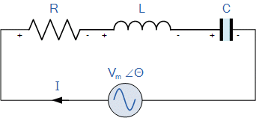
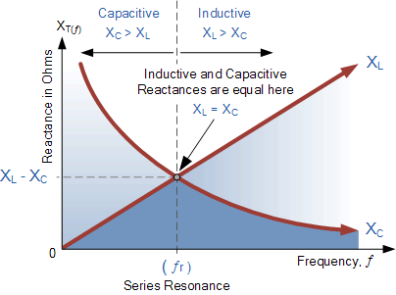
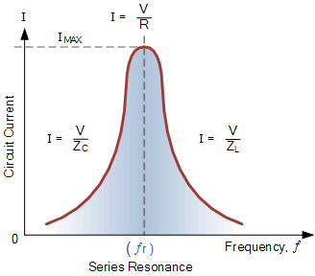
Series Resonance Circuit

Slide 4
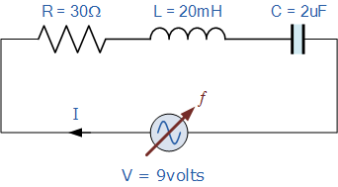
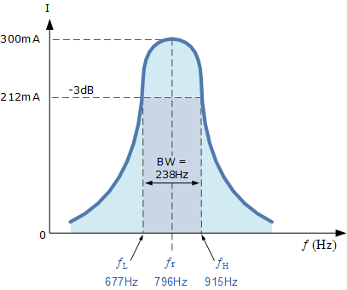
Series Resonance Example No1
A series resonance network consisting of a resistor of 30Ω, a capacitor of 2uF and an inductor of 20mH is connected across a sinusoidal supply voltage which has a constant output of 9 volts at all frequencies. Calculate, the resonant frequency, the current at resonance, the voltage across the inductor and capacitor at resonance, the quality factor and the bandwidth of the circuit. Also sketch the corresponding current waveform for all frequencies.

Slide 5
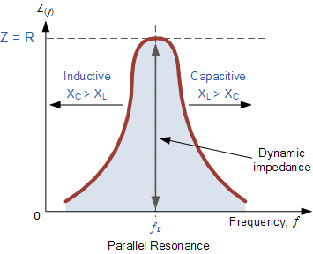
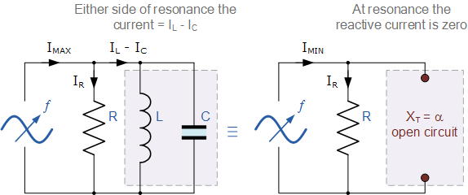
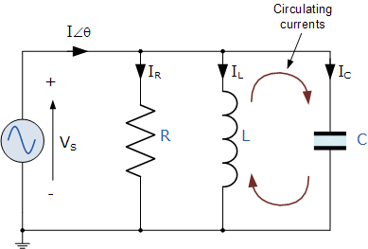
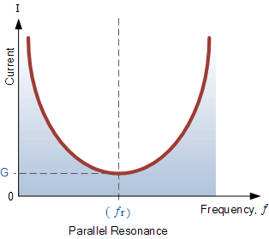
Parallel Resonance Circuit
Parallel resonance occurs when the supply frequency creates zero phase difference between the supply voltage and current producing a resistive circuit

Slide 6
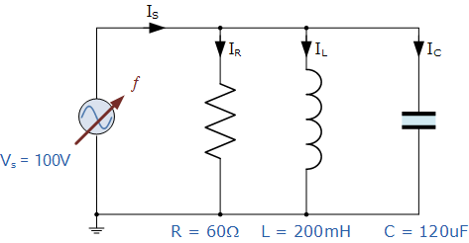
Parallel Resonance Example No1
A parallel resonance network consisting of a resistor of 60Ω, a capacitor of 120uF and an inductor of 200mH is connected across a sinusoidal supply voltage which has a constant output of 100 volts at all frequencies. Calculate, the resonant frequency, the quality factor and the bandwidth of the circuit, the circuit current at resonance and current magnification.

Slide 7
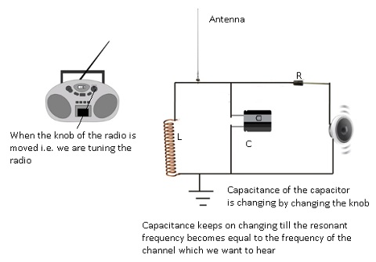





Radio application

Slide 8








Slide 9
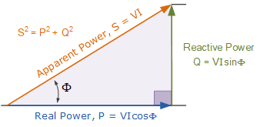
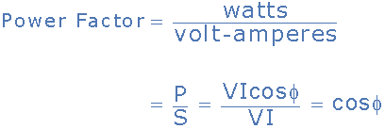
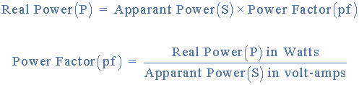
Power Triangle of an AC Circuit
P is the I²*R or Real power that performs work measured in watts, W
Q is the I²*X or Reactive power measured in volt-amperes reactive, VAr
S is the I²*Z or Apparent power measured in volt-amperes, VA
Φ is the phase angle in degrees. The larger the phase angle, the greater the reactive power

Slide 10
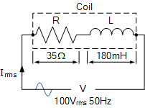
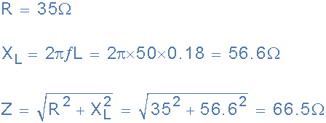
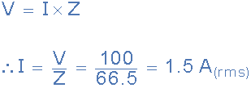
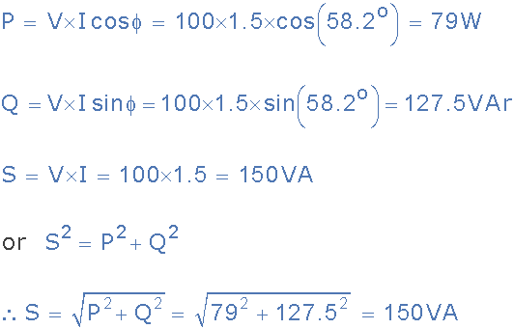
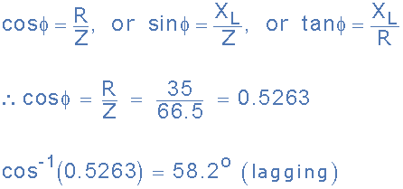
Power Triangle Example No1
A wound coil that has an inductance of 180mH and a resistance of 35Ω is connected to a 100V 50Hz supply. Calculate: a) the impedance of the coil, b) the current, c) the power factor, and d) the apparent power consumed.
Also draw the resulting power triangle for the above coil.
Data given: R = 35Ω, L = 180mH, V = 100V and ƒ = 50Hz.

Slide 11
A coil has a resistance of 10Ω and an inductance of 46mH. If it draws a current of 5 Amperes when connected to a 100Vrms, 60Hz supply, calculate:
1) the voltages across the components.
2) the phase angle of the circuit.
3) the different powers consumed by the series RL circuit.

Slide 12
